Slide 1
Data Mining and Data Warehousing CSF346
UNIT-I

Slide 2
What Is Data Mining?
Data mining (knowledge discovery from data)
Extraction of interesting (non-trivial, implicit, previously unknown and potentially useful) patterns or knowledge from huge amount of data
Alternative names
Knowledge discovery (mining) in databases (KDD), knowledge extraction, data/pattern analysis, data archeology, data dredging, information harvesting, business intelligence, etc.

Slide 3
Knowledge Discovery (KDD) Process
Knowledge
This is a view from typical database systems and data warehousing communities
Data mining plays an essential role in the knowledge discovery process
Pattern Evaluation
Data Mining
Task-relevant Data
Data Warehouse
Selection
Data Cleaning
Data Integration
Databases

Slide 4
Steps of KDD Process
1. Data cleaning (to remove noise and inconsistent data)
2. Data integration (where multiple data sources may be combined)
3. Data selection (where data relevant to the analysis task are retrieved from the
database)
4. Data transformation (where data are transformed and consolidated into forms appropriate for mining by performing summary or aggregation operations)
5. Data mining (an essential process where intelligent methods are applied to extract data patterns)
6. Pattern evaluation (to identify the truly interesting patterns representing knowledge based on interestingness measures
7. Knowledge presentation (where visualization and knowledge representation techniques are used to present mined knowledge to users)

Slide 5
Data Mining in Business Intelligence
Increasing potential
to support
business decisions
End User
Decision Making
Data Presentation
Business
Analyst
Visualization Techniques
Data Mining
Data
Analyst
Information Discovery
Data Exploration
Statistical Summary, Querying, and Reporting
Data Preprocessing/Integration, Data Warehouses
Data Sources
DBA
Paper, Files, Web documents, Scientific experiments, Database Systems

Slide 6
Data mining turns a large collection of data into knowledge
A search engine (e.g., Google) receives hundreds of millions of queries every day.
What novel and useful knowledge can a search engine learn from such a huge collection of queries collected from users over time? Interestingly, some patterns found in user search queries can disclose invaluable knowledge that cannot be obtained by reading individual data items alone.
For example, Google’s Flu Trends uses specific search terms as indicators of flu activity. It found a close relationship between the number of people who search for flu-related information and the number of people who actually have flu symptoms
The idea behind Google Flu Trends was that, by monitoring millions of users’ health tracking behaviors online, the large number of Google search queries gathered can be analyzed to reveal if there is the presence of flu-like illness in a population. Google Flu Trends compared these findings to a historic baseline level of influenza activity for its corresponding region and then reports the activity level as either minimal, low, moderate, high, or intense. These estimates have been generally consistent with conventional surveillance data collected by health agencies, both nationally and regionally.

Slide 7




Why Data Mining? Commercial Viewpoint
Lots of data is being collected and warehoused
Web data
Google has Peta Bytes of web data
Facebook has billions of active users
purchases at department/ grocery stores, e-commerce
Amazon handles millions of visits/day
Bank/Credit Card transactions
Computers have become cheaper and more powerful
Competitive Pressure is Strong
Provide better, customized services for an edge (e.g. in Customer Relationship Management)
Notes:
7

Slide 8
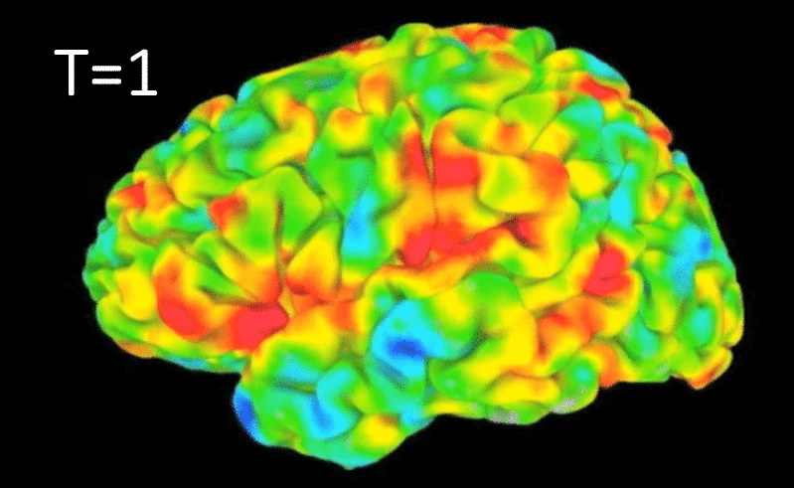
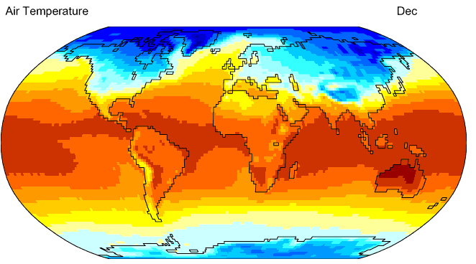
Why Data Mining? Scientific Viewpoint
Data collected and stored at enormous speeds
remote sensors on a satellite
NASA archives over petabytes of earth science data / year
telescopes scanning the skies
Sky survey data
High-throughput biological data
scientific simulations
terabytes of data generated in a few hours
Data mining helps scientists
in automated analysis of massive datasets
In hypothesis formation
fMRI Data from Brain
Sky Survey Data
Gene Expression Data
Surface Temperature of Earth
Notes:
8

Slide 9
Data Mining: On What Kinds of Data?
Database-oriented data sets and applications
Relational database, data warehouse, transactional database
Advanced data sets and advanced applications
Data streams and sensor data
Time-series data, temporal data, sequence data (incl. bio-sequences)
Structure data, graphs, social networks and multi-linked data
Object-relational databases
Heterogeneous databases and legacy databases
Spatial data and spatiotemporal data
Multimedia database
Text databases
The World-Wide Web

Slide 10
1. Relational database Example
Customer (cust ID, name, address, age, occupation, annual income, credit information, category, . . . )
item (item ID, brand, category, type, price, place made, supplier, cost, . . . )
employee (empl ID, name, category, group, salary, commission, . . . )
branch (branch ID, name, address, . . . )
purchases (trans ID, cust ID, empl ID, date, time, method paid, amount)
Items_sold (trans ID, item ID, qty)
Works_at (empl ID, branch ID)
Relational schema for a relational database,
When mining relational databases, we can go further by searching for trends or data patterns.
For example, data mining systems can analyze customer data to predict the credit risk of new customers based on their income, age, and previous credit information.

Slide 11
2. Data Warehouses
A data warehouse is a repository of information collected from multiple sources, stored under a unified schema, and usually residing at a single site. Data warehouses are constructed via a process of data cleaning, data integration, data transformation, data loading, and periodic data refreshing.

Slide 12
What is a Data Warehouse?
Defined in many different ways, but not rigorously.
A decision support database that is maintained separately from the organization’s operational database
Support information processing by providing a solid platform of consolidated, historical data for analysis.
“A data warehouse is a subject-oriented, integrated, time-variant, and nonvolatile collection of data in support of management’s decision-making process.”—W. H. Inmon
Data warehousing:
The process of constructing and using data warehouses

Slide 13
Data Warehouse—Subject-Oriented
Organized around major subjects, such as customer, product, sales
Focusing on the modeling and analysis of data for decision makers, not on daily operations or transaction processing
Provide a simple and concise view around particular subject issues by excluding data that are not useful in the decision support process

Slide 14
Data Warehouse—Integrated
Constructed by integrating multiple, heterogeneous data sources
relational databases, flat files, on-line transaction records
Data cleaning and data integration techniques are applied.
Ensure consistency in naming conventions, encoding structures, attribute measures, etc. among different data sources
E.g., Hotel price: currency, tax, breakfast covered, etc.
When data is moved to the warehouse, it is converted.

Slide 15
Data Warehouse—Time Variant
The time horizon for the data warehouse is significantly longer than that of operational systems
Operational database: current value data
Data warehouse data: provide information from a historical perspective (e.g., past 5-10 years)
Every key structure in the data warehouse
Contains an element of time, explicitly or implicitly
But the key of operational data may or may not contain “time element”

Slide 16
Data Warehouse—Nonvolatile
A physically separate store of data transformed from the operational environment
Operational update of data does not occur in the data warehouse environment
Does not require transaction processing, recovery, and concurrency control mechanisms
Requires only two operations in data accessing:
initial loading of data and access of data

Slide 17
Data Cube: A Multidimensional Data Model
A data cube allows data to be modeled and viewed in multiple dimensions. It is defined by dimensions and facts.
Dimensions are the perspectives or entities with respect to which an organization wants to keep records.
For example, an organization may create a sales data warehouse in order to keep records of the store’s sales with respect to the dimensions time, item, branch, and location. These dimensions allow the store to keep track of things like monthly sales of items and the branches and locations at which the items were sold. Each dimension may have a table associated with it, called a dimension table, which further describes the dimension. For example, a dimension table for item may contain the attributes item name, brand, and type.
Dimension tables, such as item (item_name, brand, type), or time(day, week, month, quarter, year)

Slide 18
A multidimensional data model is typically organized around a central theme, such as sales. This theme is represented by a fact table. Facts are numeric measures. Think of them as the quantities by which we want to analyze relationships between dimensions.
Examples of facts for a sales data warehouse include dollars sold (sales amount in dollars), units sold (number of units sold), and the amount budgeted. The fact table contains the names of the facts, or measures, as well as keys to each of the related dimension tables.
Fact table contains measures (such as dollars_sold) and keys to each of the related dimension tables

Slide 19
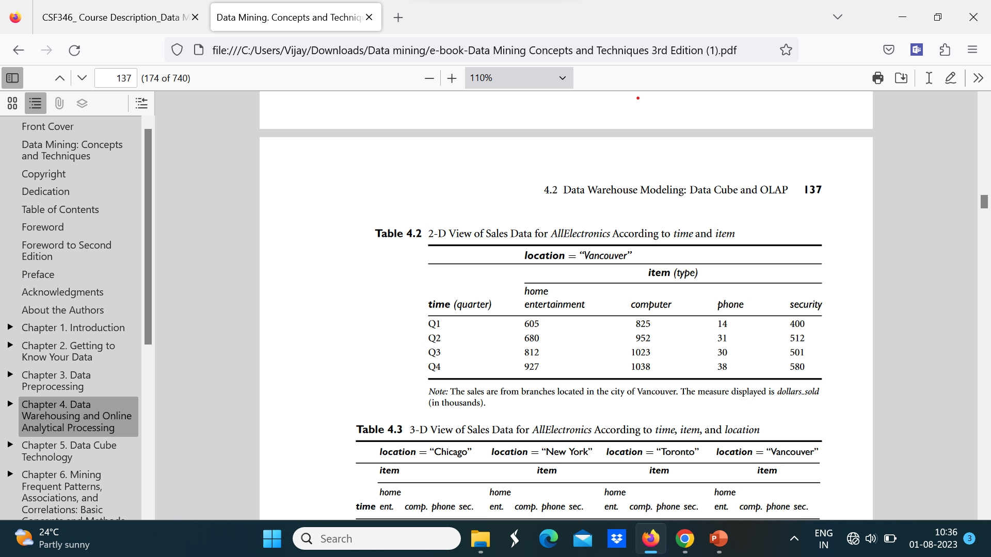
Table: 2-D view of Sales Data for organization according to time and item

Slide 20
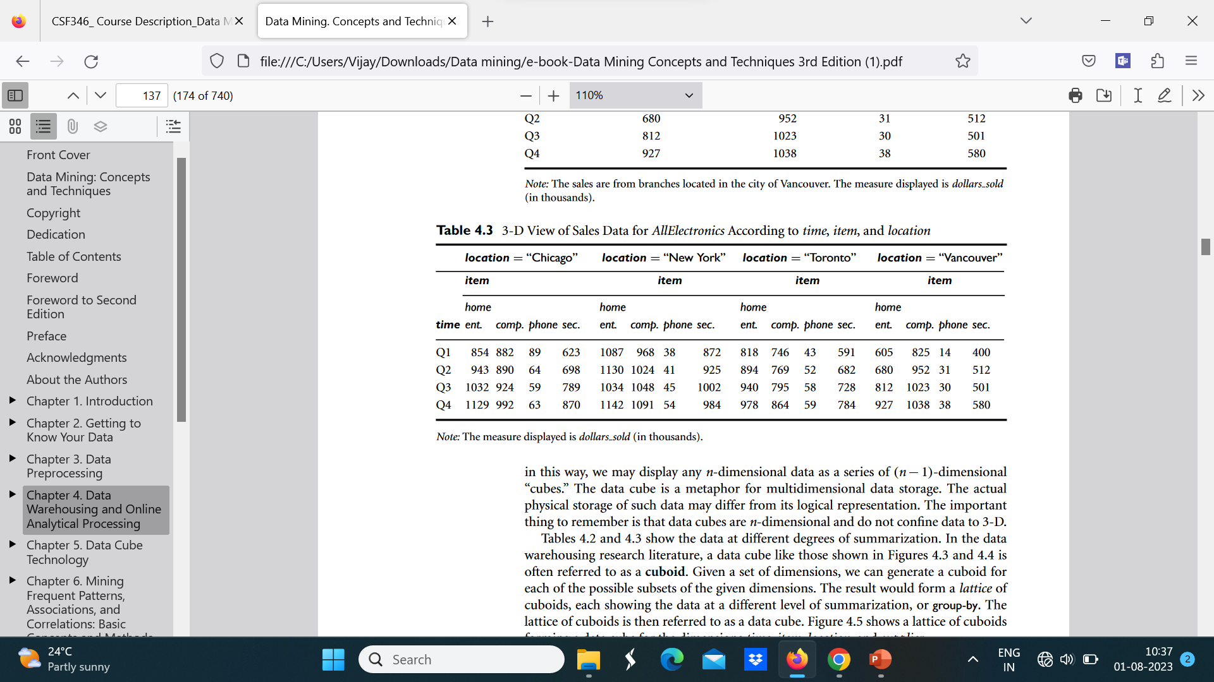
Table: 3-D view of Sales Data for organization according to time, item, and location

Slide 21
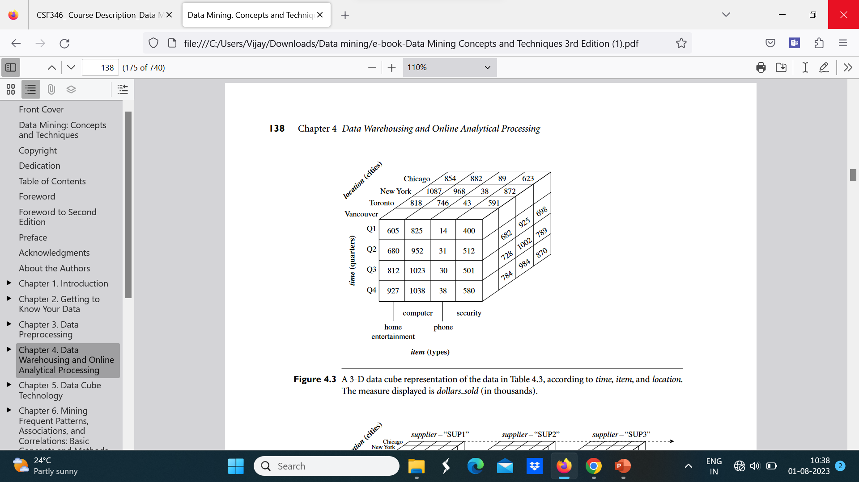

Slide 22
Stars, Snowflakes, and Fact Constellations: Schemas for Multidimensional Data Models
The most popular data model for a data warehouse is a multidimensional model,
which can exist in the form of a star schema, a snowflake schema, or a fact constellation
Schema.
Star schema: The most common modeling paradigm is the star schema, in which the
data warehouse contains
(1) a large central table (fact table) containing the bulk of the data, with no redundancy.
(2) a set of smaller attendant tables (dimension tables), one for each dimension. The schema graph resembles a starburst, with the dimension tables displayed in a radial pattern around the central fact table

Slide 23
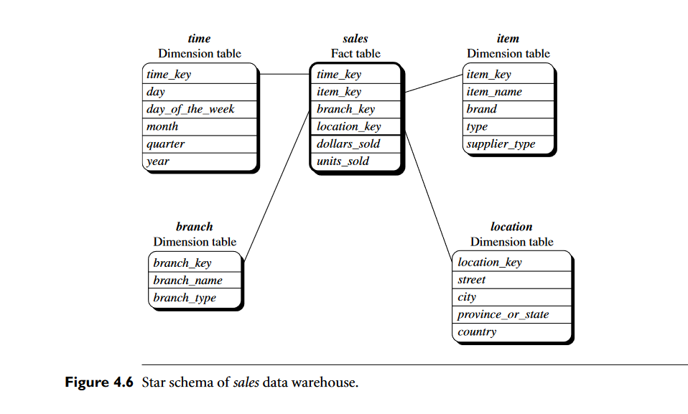

Slide 24
Snowflake schema
The snowflake schema is a variant of the star schema model, where some dimension tables are normalized, thereby further splitting the data into additional tables. The resulting schema graph forms a shape similar to a snowflake
The major difference between the snowflake and star schema models is that the dimension tables of the snowflake model may be kept in normalized form to reduce redundancies. Such a table is easy to maintain and saves storage space. However, this space savings is negligible in comparison to the typical magnitude of the fact table. Furthermore, the snowflake structure can reduce the effectiveness of browsing, since more joins will be needed to execute a query. Consequently, the system performance may be adversely impacted. Hence, although the snowflake schema reduces redundancy, it is not as popular as the star schema in data warehouse design.

Slide 25
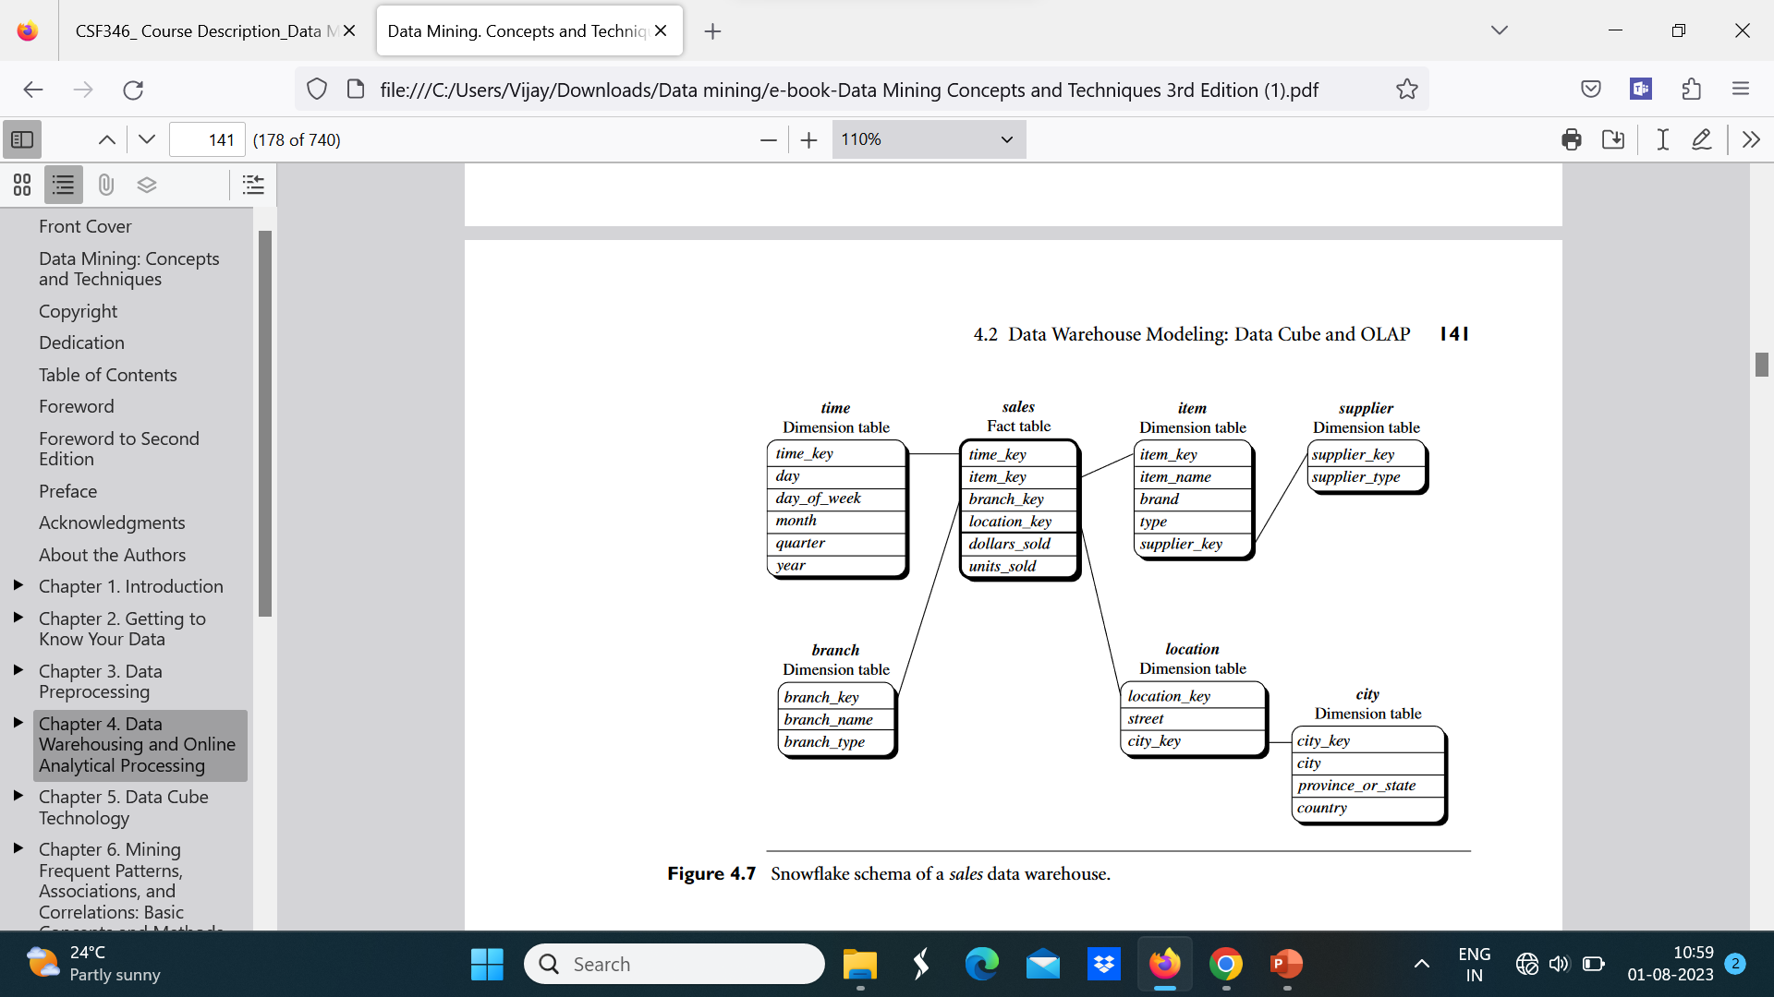

Slide 26
Advantages:
Reduced data redundancy: The snowflake schema reduces data redundancy by normalizing dimensions into multiple tables, resulting in a more efficient use of storage space.
Improved performance: The snowflake schema can improve query performance, as it requires fewer joins to retrieve data from the fact table.
Scalability: The snowflake schema is scalable, making it suitable for large data warehousing projects with complex hierarchies.

Slide 27
Disadvantages:
Increased complexity: The snowflake schema can be more complex to implement and maintain due to the additional tables needed for the normalized dimensions.
Reduced query performance: The increased complexity of the snowflake schema can result in reduced query performance, particularly for queries that require data from multiple dimensions.
Data integrity: The snowflake schema can be more difficult to maintain data integrity due to the additional relationships between tables.

Slide 28
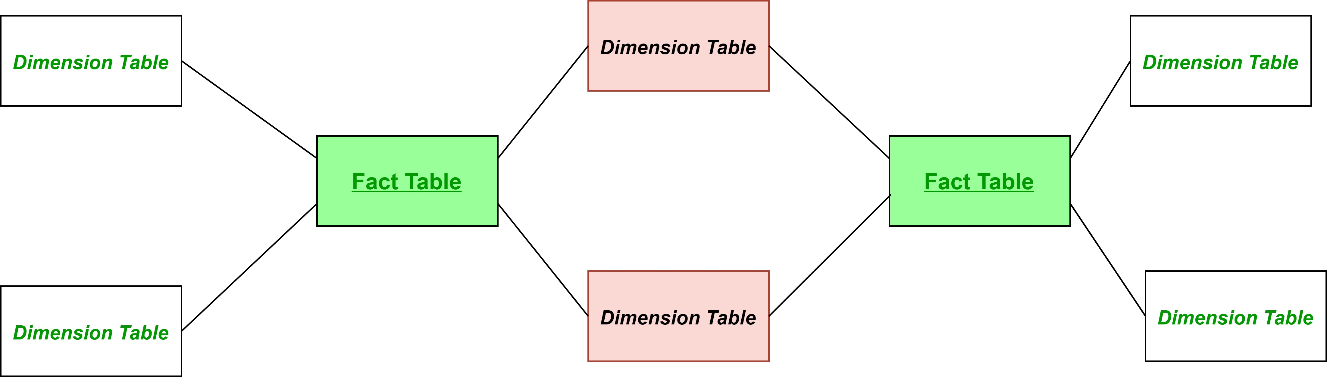
Fact constellation:
Sophisticated applications may require multiple fact tables to share dimension tables. This kind of schema can be viewed as a collection of stars, and hence is called a galaxy schema or a fact constellation. Fact Constellation is a schema for representing multidimensional model. It is a collection of multiple fact tables having some common dimension tables. It can be viewed as a collection of several star schemas and hence, also known as Galaxy schema. It is one of the widely used schema for Data warehouse designing and it is much more complex than star and snowflake schema. For complex systems, we require fact constellations

Slide 29
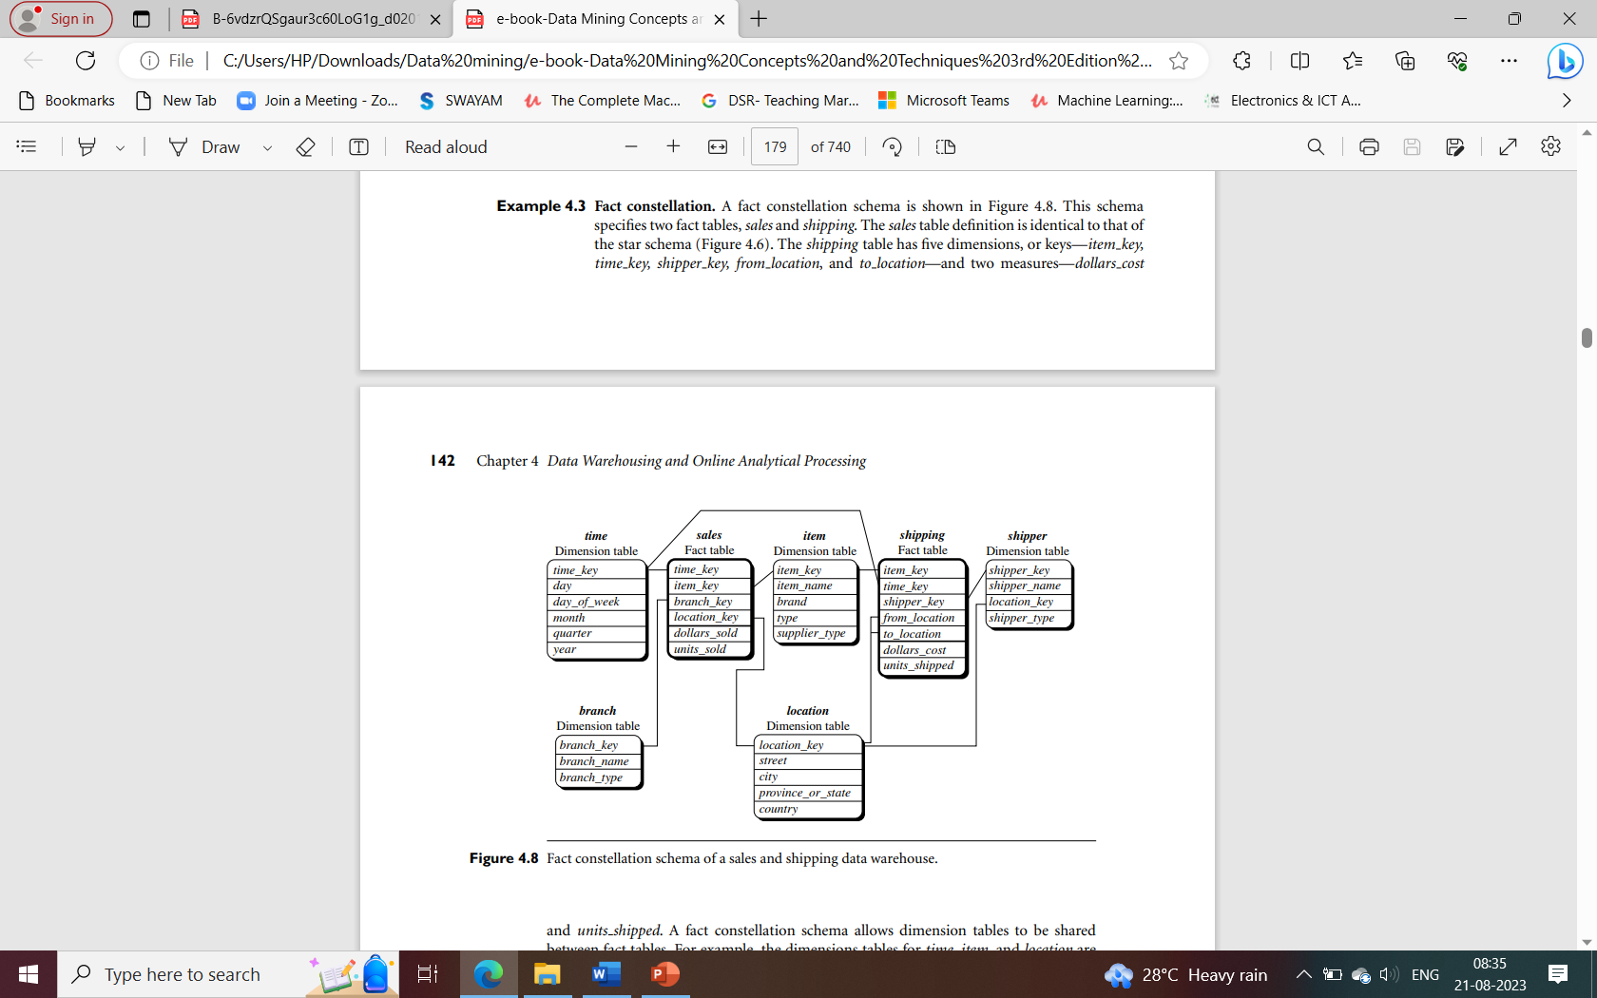
This schema specifies two fact tables, sales and shipping. The sales table definition is identical to that of the star schema. The shipping table has five dimensions, or keys—item key, time key, shipper key, from location, and to location—and two measures—dollars cost and units shipped. A fact constellation schema allows dimension tables to be shared between fact tables. For example, the dimensions tables for time, item, and location are shared between the sales and shipping fact tables.

Slide 30
Advantages:
Simple to understand: The fact constellation schema is easy to understand and maintain, as it consists of a multiple fact table and multiple dimension tables.
Improved query performance: The fact constellation schema can improve query performance by reducing the number of joins required to retrieve data from the fact table.
Flexibility: The fact constellation schema is flexible, allowing for the addition of new dimensions without affecting the existing schema.

Slide 31
Disadvantages:
Increased data redundancy: The fact constellation schema can result in increased data redundancy due to repeated dimension data across multiple fact tables.
Storage space: The fact constellation schema may require more storage space than the snowflake schema due to the denormalized dimensions.
Limited scalability: The fact constellation schema may not be as scalable as the snowflake schema for large data warehousing projects with complex hierarchies.

Slide 32
Difference between Snowflake Schema and Fact Constellation Schema:
S.No | Snowflake Schema | Fact Constellation
1 | Snowflake schema contains the large central fact table, dimension tables and sub dimension tables. | While in fact constellation schema, dimension tables are shared by many fact tables.
2 | Snowflake schema saves significant storage. | While fact constellation schema does not save storage.
3 | The snowflake schema consists of one star schema at a time. | Whereas the fact constellation schema consists of more than one star schema at a time
4 | In snowflake schema, tables can be maintained easily. | In fact constellation schema, the tables are tough to maintain.
5 | Snowflake schema is a normalized form of star schema. | While fact constellation schema is a normalized form of snowflake schema and star schema.
6 | Snowflake schema is easy to operate as compared to fact constellation schema as it has less number of joins between the tables. | Fact constellation schema is not easy to operate as compared to snowflake schema as it has multiple number of joins between the tables.
7 | In snowflake schema, to access the data from database simple and less complex query is used. | While in fact constellation schema, to access the data from database heavier complex query is used.

Slide 33
Three-Tier Data Warehouse Architecture
Data Warehouses usually have a three-level (tier) architecture that includes:
Bottom Tier (Data Warehouse Server)
Middle Tier (OLAP Server)
Top Tier (Front end Tools).

Slide 34
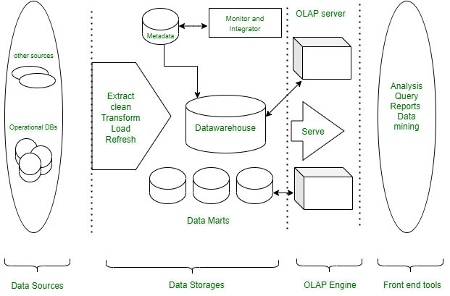

Slide 35
Bottom Tier(Data sources and data storage) :
The bottom Tier usually consists of Data Sources and Data Storage.
It is a warehouse database server. For Example RDBMS.
In Bottom Tier, using the application program interface(called gateways), data is extracted from operational and external sources.
Application Program Interface likes ODBC(Open Database Connection), OLE-DB(Open-Linking and Embedding for Database), JDBC(Java Database Connection) is supported.
ETL stands for Extract, Transform, and Load.
Several popular ETL tools include: I. IBM Infosphere II. Informatica III. Confluent IV. Microsoft SSIS V. Snaplogic VI. Alooma

Slide 36
Middle Tier :
The middle tier is an OLAP server that is typically implemented using either : A relational OLAP (ROLAP) model (i.e., an extended relational DBMS that maps operations from standard data to standard data); or A multidimensional OLAP (MOLAP) model (ie, a special purpose server that directly implements multidimensional data and operations).
The OLAP server is implemented using either
(1) A Relational OLAP (ROLAP) model, i.e., an extended relational DBMS that maps functions on multidimensional data to standard relational operations.
(2) A Multidimensional OLAP (MOLAP) model, i.e., a particular purpose server that directly implements multidimensional information and operations.
A top-tier that contains front-end tools for displaying results provided by OLAP, as well as additional tools for data mining of the OLAP-generated data.

Slide 37
Top Tier :
The top tier is a front-end client layer, which includes query and reporting tools, analysis tools, and/or data mining tools (eg, trend analysis, prediction, etc.).
Here are a few Top Tier tools that are often used: I. SAP BW II. SAS Business Intelligence III. IBM Cognos IV. Crystal Reports V. Microsoft BI Platform

Slide 38
Data Warehouse Models :
From the architecture point of view, there are three warehouse models-
Enterprise Warehouse:-
An enterprise warehouse collects all information topics spread throughout the organization.
It provides corporate-wide data integration, typically from one or several operational systems or external information providers, and is cross-functional in scope.
It usually contains detailed data as well as summarized data and can range in size from a few gigabytes to hundreds of gigabytes, terabytes, or beyond. Can be an enterprise data warehouse.
The traditional mainframe, computer super server, or parallel architecture has been implemented on platforms. This requires extensive commercial modeling and may take years to design and manufacture.

Slide 39
Data Mart:-
A data mart contains a subset of corporate-wide data that is important to a specific group of users.
The scope is limited to specific selected subjects.
For example, a marketing data mart may limit its topics to customers, goods, and sales.
The data contained in the data marts are summarized. Data marts are typically applied to low-cost departmental servers that are Unix/Linux or Windows-based.
The implementation cycle of a data mart is more likely to be measured in weeks rather than months or years. However, it can be in the long run, complex integration is involved in its design and planning were not enterprise-wide.

Slide 40
Virtual Warehouse:-
A virtual warehouse is a group of views on an operational database.
For efficient query processing, only a few possible summary views can be physical.
Creating a virtual warehouse is easy, but requires additional capacity on operational database servers.

Slide 41
Advantages of Multi-Tier Architecture of Data warehouse
Scalability: Various components can be added, deleted, or updated in accordance with the data warehouse’s shifting needs and specifications.
Better Performance: The several layers enable parallel and efficient processing, which enhances performance and reaction times.
Modularity: The architecture supports modular design, which facilitates the creation, testing, and deployment of separate components.
Security: The data warehouse’s overall security can be improved by applying various security measures to various layers.
Improved Resource Management: Different tiers can be tuned to use the proper hardware resources, cutting expenses overall and increasing
Easier Maintenance: Maintenance is simpler because individual components can be updated or maintained without affecting the data warehouse as a whole.
Improved Reliability: Using many tiers can offer redundancy and failover capabilities, enhancing the data warehouse’s overall reliability.

